Slide 1
Quantitative Modeling of Intubation at Scale
An Open-Source Intubation Calculator
Sean Runnels MD
Associate Prof Anesthesiology
University of Utah
Cam Norris MD
Assistant Prof Anesthesiologist
University of Utah

Slide 2
Disclosures
Runnels
Associate Professor at the University of Utah
Inventor of Runnels Steerable Introducer
CEO of TTCmed.com
Co-Director of ASA/FAER Swimming with Sharks
Norris
None
.

Slide 3
Understanding Objectives
Modeling DL era to VL era transition
  Clinical outcomes
  Economic outcomes
  Cause and scaled impact of first pass failure

Slide 4

Why Build a Mathematical Model of Intubation Practices??
Data Integration
Scenario Building
Prediction and insight
Scaling Outcomes
Decision Support

Slide 5

Link to Calculator
https://sites.google.com/view/intubation-calculator/edicu-intubation-calculator

Slide 6
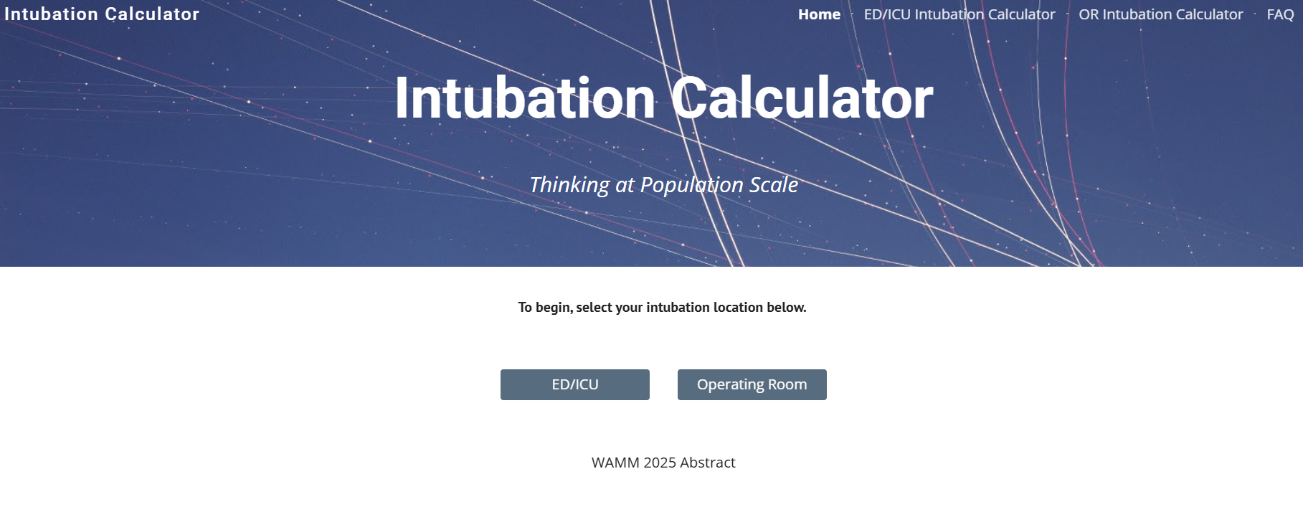

Slide 7
Questions for the Calculator

Slide 8
What is the main cause of first pass failure as VL use increases?

Slide 9
DL Clinical Problem!
“Can Not See”
Visualization Failure

Slide 10
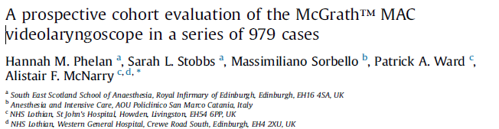
VL Clinical Problem!
“I Can See The Cords, But I Can’t Deliver the Tube!”
Tracheal Access Failure

Slide 11


Slide 12
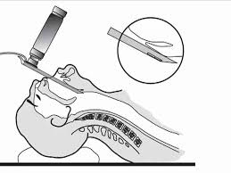
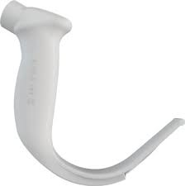
VL vs DL Kriege 2023 (OR)
Primary Curve
  First pass rate
    VL 94%
    DL 82%
Secondary Curve
Failure Mode
 | DL | VL
Visualization | 84% | 14%
Tracheal access | 16% | 86%

Slide 13
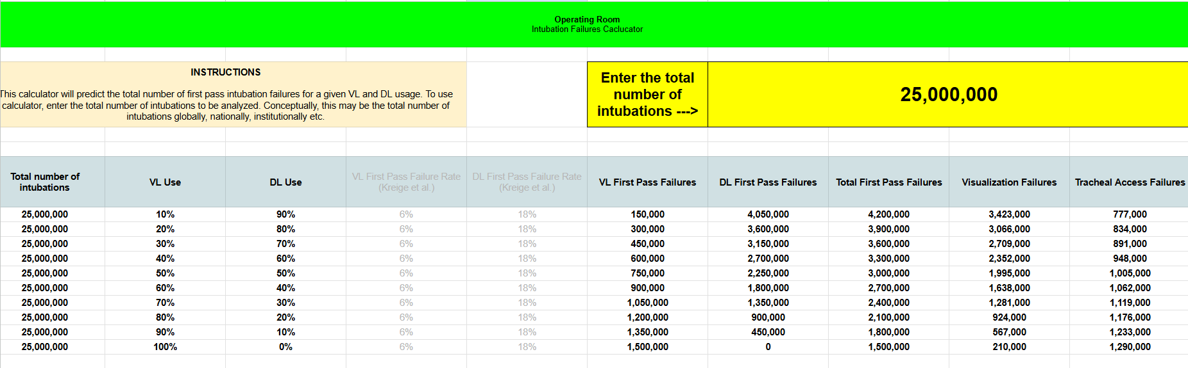
First Pass Failure and Attempt Failure Mode
OR intubations (Kriege 2023)

Slide 14
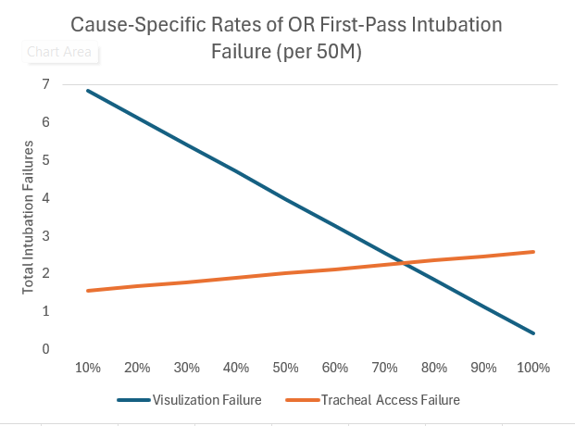
VL Use Percent

Slide 15
Insight
As VL use increases:
Total first pass failures decrease
First pass failure due to visualization decreases
First pass failure due to tracheal access issues increases

Slide 16
When Will Failure of Tracheal Access Overtake Failure of Visualization As the Main Cause of First Pass Failure??

Slide 17
75% VL Use
VL Use Percent

Slide 18
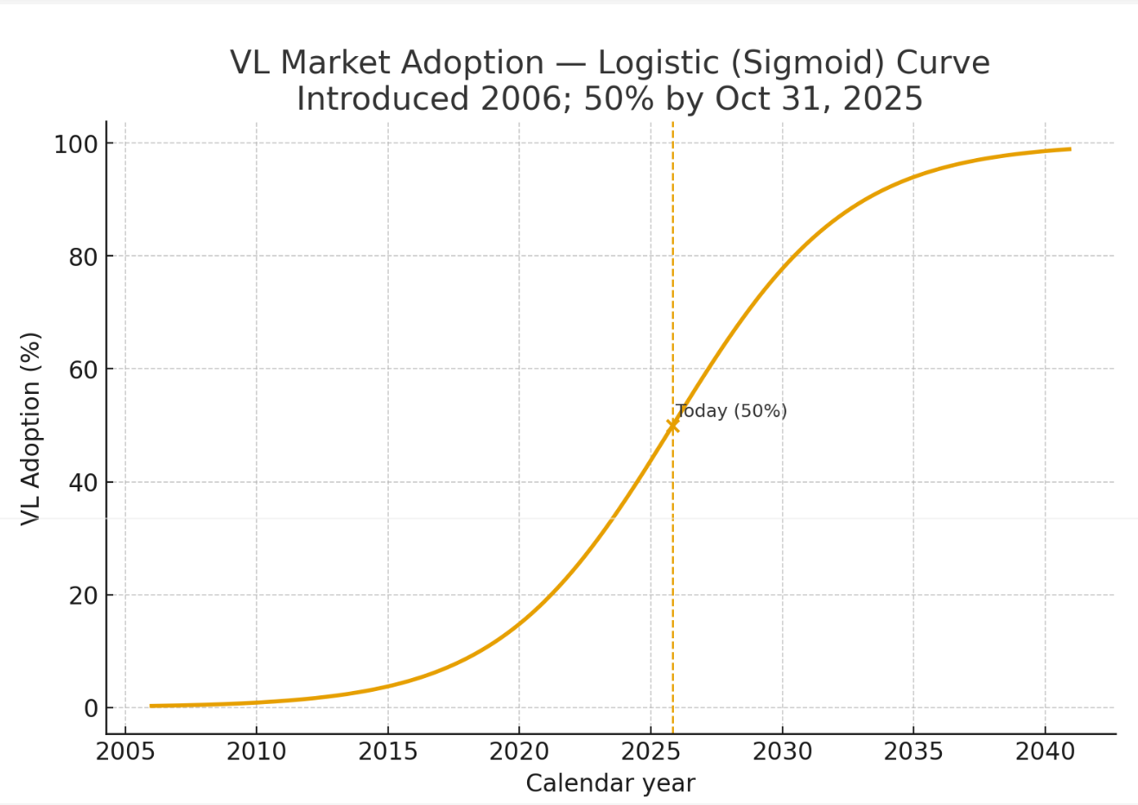
75% Adoption
Prediction
2028-29
Ambu
Markets Day
Report2025

Slide 19
What Is the Excess Cost of 3+ Intubation Attempts in OR per Year in the USA??
Economic Cost and Scale

Slide 20

COST BURDEN ASSOCIATED WITH DIFFICULT INTUBATION IN THE
UNITED STATES
Karen Phillips 1,
Abstracts / Trends in Anaesthesia and Critical Care 30 (2020) e1ee192

Slide 21
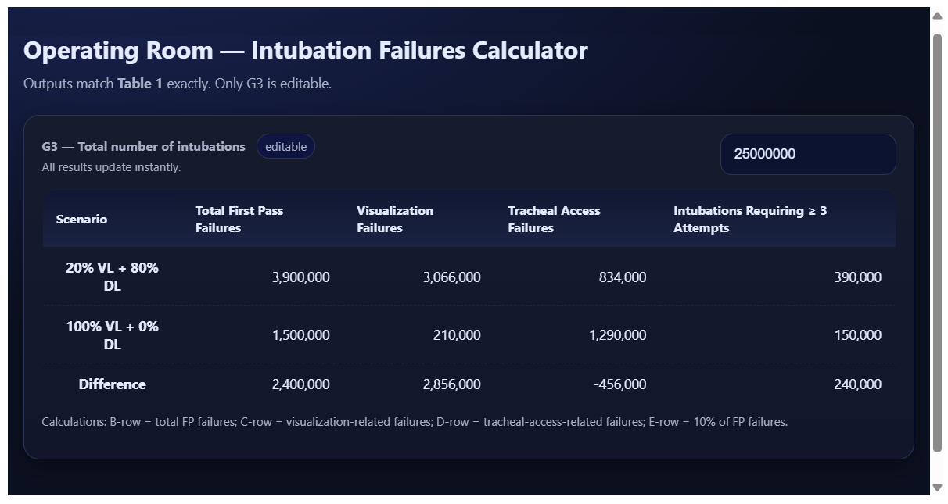
20% VL
$20,000 X 390,000 = $7.8 Billion
100% VL
$20,000 X 150,000 = $3.9 Billion
Savings….$3.9 Billion

Slide 22
Should I do 30% of my intubations with DL to keep up my DL skills??
Decision Support

Slide 23
The Cost of Retaining DL Skills
30% of intubations with DL
 | ED/ICU (10M) | OR (50M)
First Pass Failures @ 30% DL | 1,919,000 | 4,800,000
First Pass Failures@ 100% VL | 1,490,000 | 3,000,000
Excess First Pass Failures | 429,000 | 1,800,000
Excess Deaths and costs

Slide 24
Link to Calculator
https://sites.google.com/view/intubation-calculator/edicu-intubation-calculator

Slide 25
What Is the cost in 28-day ICU mortality at 20% VL use and 100% VL use?
Clinical Cost and Scale

Slide 26
VL vs DL Prekker 2023 (ED ICU)
Primary Curve
  First pass rate
    VL 85.1%
    DL 70.8%
Secondary Curve
Failure Mode
 | DL | VL
Visualization | 71% | 34%
Tracheal access | 29% | 66%

Slide 27

Linked
# of intubation attempts
major adverse events
28 Day ICU mortality

Slide 28
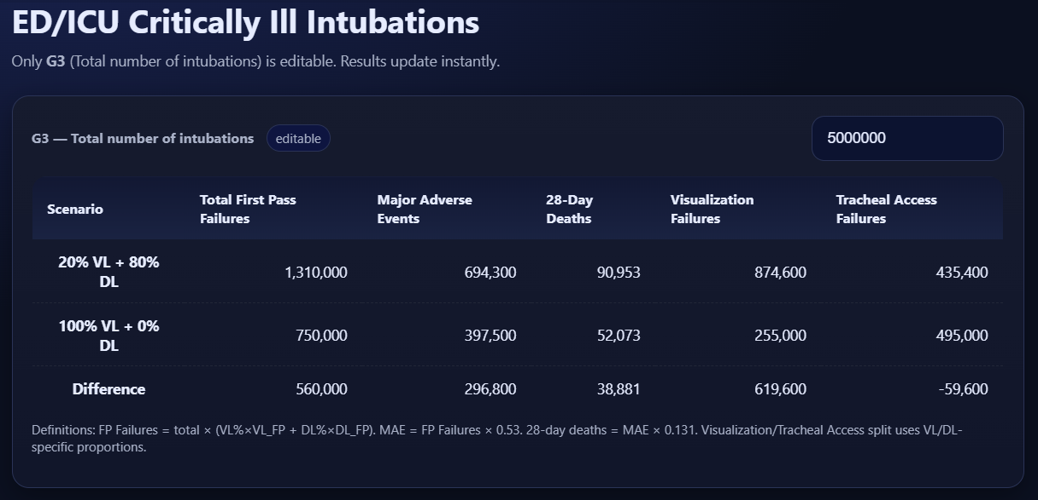
National Scale Critically Ill (5 Million Per Year)

